Slide 1
What We Do (not?) Know About Quantization
Sergey Salishev

Slide 2
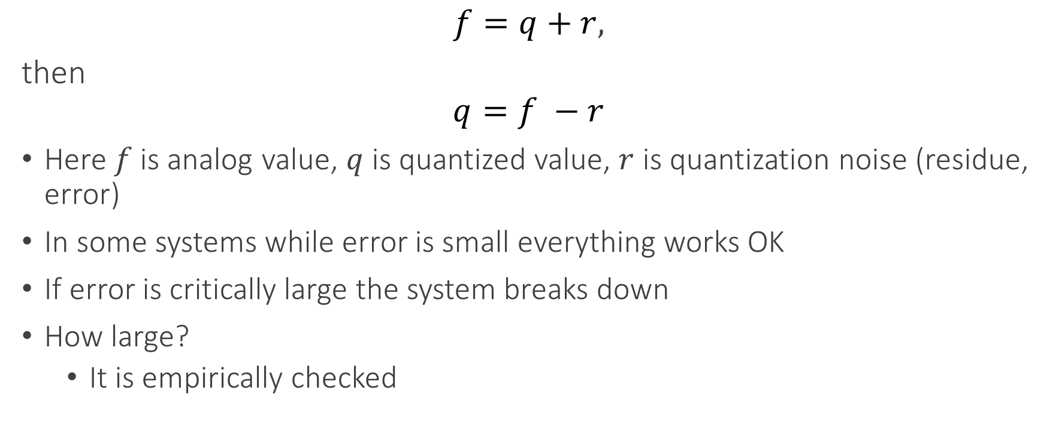
How Engineers See Quantization
$$f=q+r,$$
then
$$q=f −r$$
Here $f$is analog value, $q$ is quantized value, $r$ is quantization noise (residue, error)
In some systems while error is small everything works OK
If error is critically large the system breaks down
How large?
It is empirically checked

Slide 3
The Big Question
Consider discrete feedforward networks
Digital Artificial NN
Digital Circuits, e.g. multiplier
Artificial NN usually tolerate some noise, while Digital Circuits do not
What is the difference?

Slide 4
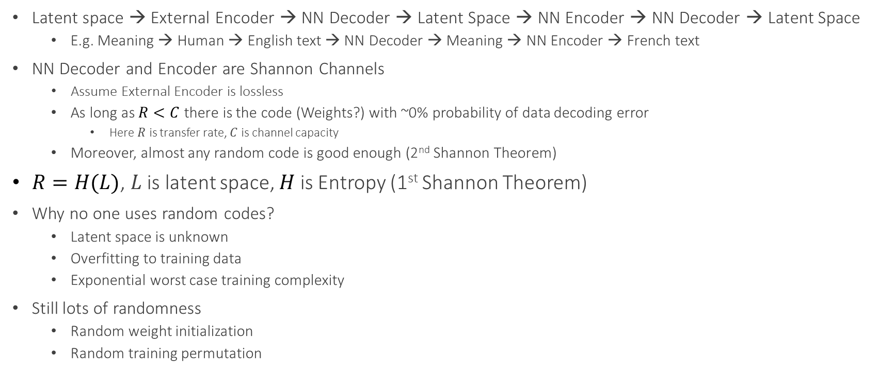
Information Theory View on NN
Latent space → External Encoder → NN Decoder → Latent Space → NN Encoder → NN Decoder → Latent Space
E.g. Meaning → Human → English text → NN Decoder → Meaning → NN Encoder → French text
NN Decoder and Encoder are Shannon Channels
Assume External Encoder is lossless
As long as $R<C$ there is the code (Weights?) with ~0% probability of data decoding error
Here $R$ is transfer rate, $C$ is channel capacity
Moreover, almost any random code is good enough (2nd Shannon Theorem)
$R=H(L)$, $L$ is latent space, $H$ is Entropy (1st Shannon Theorem)
Why no one uses random codes?
Latent space is unknown
Overfitting to training data
Exponential worst case training complexity
Still lots of randomness
Random weight initialization
Random training permutation

Slide 5
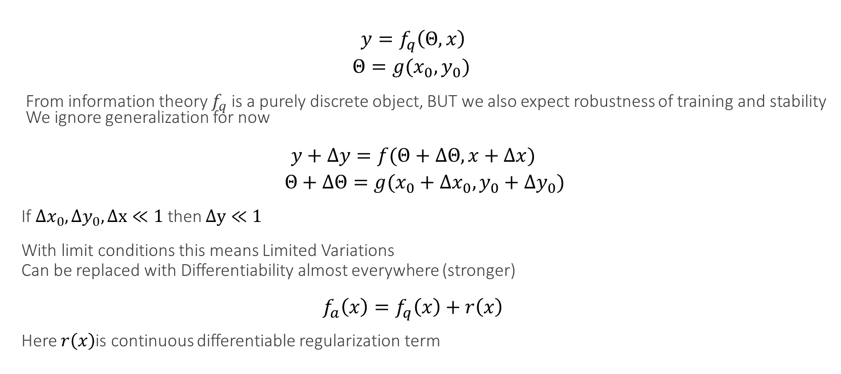
Why Does Gradient Descent Even Work on NN?
$$y=f_{q}\left(Θ, x\right)$$
$$Θ=g(x_{0},y_{0})$$
From information theory $f_{q}$ is a purely discrete object, BUT we also expect robustness of training and stability
We ignore generalization for now
$$y+Δy=f(Θ+ΔΘ,x+Δx)$$
$$Θ+ΔΘ=g(x_{0}+Δx_{0},y_{0}+Δy_{0})$$
If$Δx_{0},Δy_{0},Δx≪1$ then $Δy≪1$
With limit conditions this means Limited Variations
Can be replaced with Differentiability almost everywhere (stronger)
$$f_{a}\left(x\right)=f_{q}\left(x\right)+r\left(x\right)$$
Here $r\left(x\right)$is continuous differentiable regularization term

Slide 6
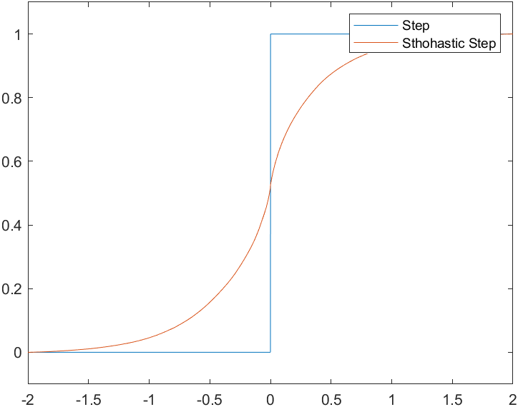
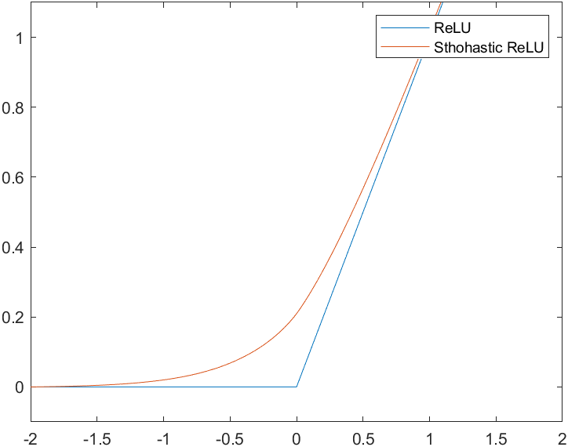
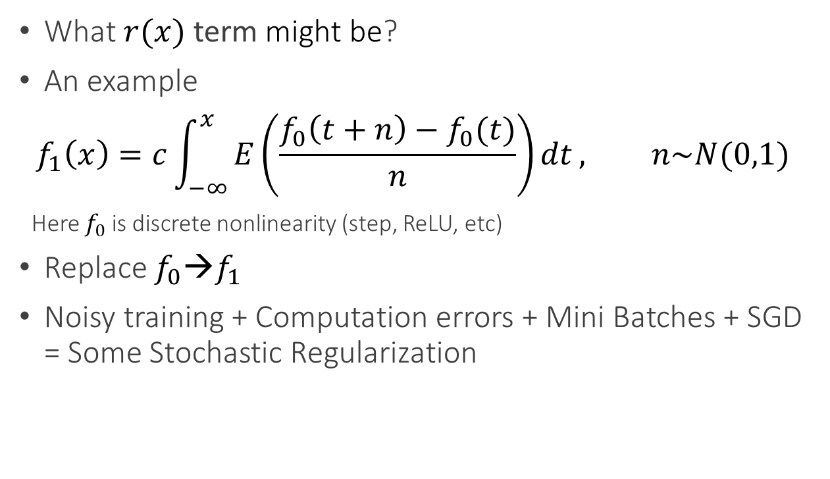
Stochastic Regularization
What $r(x)$ term might be?
An example
$$f_{1}\left(x\right)=c\int_{−∞}^{x}{E\left(\frac{f_{0}\left(t+n\right)−f_{0}(t)}{n}\right)dt}, n\sim N(0,1)$$
Here $f_{0}$ is discrete nonlinearity (step, ReLU, etc)
Replace $f_{0}$→$f_{1}$
Noisy training + Computation errors + Mini Batches + SGD = Some Stochastic Regularization

Slide 7
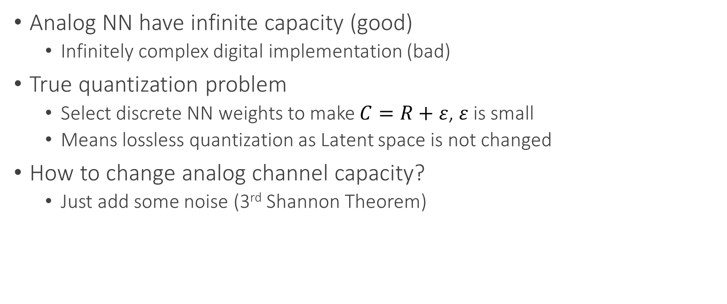
Analog Meets Digital
Analog NN have infinite capacity (good)
Infinitely complex digital implementation (bad)
True quantization problem
Select discrete NN weights to make $C=R+ε$, $ε$ is small
Means lossless quantization as Latent space is not changed
How to change analog channel capacity?
Just add some noise (3rd Shannon Theorem)

Slide 8
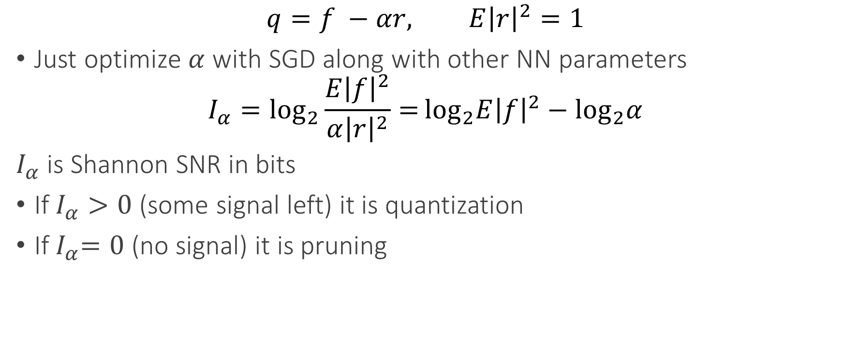
Back to Engineering
$$q=f −αr, E{\left|r\right|}^{2}=1$$
Just optimize $α$ with SGD along with other NN parameters
$$I_{α}=\log_{2}{\frac{E{\left|f\right|}^{2}}{α{\left|r\right|}^{2}}=}\log_{2}E{\left|f\right|}^{2}−\log_{2}α$$
$I_{α}$ is Shannon SNR in bits
If$I_{α}>0$ (some signal left) it is quantization
If${ I}_{α}=0$ (no signal) it is pruning

Slide 9
Open Questions
Can we deduce differentiability almost everywhere by formalizing generalization?
Is there a closed form for stochastic regularization depending on the noise distribution?
What are sufficient conditions of convergence of differentiable stochastic quantization?
What are sufficient conditions of convergence of stochastic approximation of stochastic quantization with quantization noise only?

